Slide 1
Introduction to jQuery Braelyn Sullivan | Consultant
Notes:
Welcome to our introduction to jquery workshop

Slide 2

Agenda
Intended Audience
Brief History of jQuery
Using Selectors
Dynamic Styling
DOM Manipulation
Event Handling
Q&A
Braelyn Sullivan Front End Consultant
Notes:
My name is Braelyn Sullivan and I am a Front End consultant with CapTech Ventures, a sponsor of this event.
In this workshop, we will go over the following items:
Intended audience
A brief history of jquery
Using selectors
Dynamic styling
DOM Manipulation
Event handling
Q&A Session

Slide 3
Intended Audience
No prior knowledge required for this session
HTML & CSS knowledge will be helpful
Advanced JavaScript users may find other session(s) more helpful
Notes:
Intended for beginners.
The material we will cover requires no previous knowledge; however, some knowledge of HTML and CSS will be helpful in understanding the examples.
Any advanced JavaScript or web developers may find another session more valuable

Slide 4
What is jQuery?
One of the most widely deployed JavaScript libraries in the world
Document Object Model (DOM) Manipulation library
Designed to simplify client-side scripting of HTML:
Navigate the DOM
Create/Remove elements
Event handlers
Animations*
Ajax*
Still being maintained and updated today
https://jquery.com/
*Not covered in this session
Notes:
jQuery is one of the most widely deployed JavaScript libraries worldwide
It is primarily a Document Object Model, or DOM, manipulation library
jQuery was designed to simplify client-side scripting of HTML by using css selectors to
Navigate the DOM
Create/Remove elements
Event handling
Animations and effects
Ajax / Server interactions
NOTE: Animations and Ajax are advanced topics that will not be covered in this session
jQuery is still being maintained and updated today
Check the jquery website for more information or updates

Slide 5
History of jQuery
2006
2008
2013
2018
First stable release of jQuery
Microsoft and Nokia announce support for jQuery
jQuery 2.0 stable released
Current Version: 3.3.1 released
jQuery UI introduced
jQuery Mobile announced and released
jQuery 3.0 released
2007
2010
2016
Notes:
This is a very brief history of jQuery:
The first stable version of jQuery was released for use in 2006
By 2007, the first jQuery extension, jQuery UI, was released
In 2008, Microsoft and Nokie bundled jQuery into their services
2010 brought jQuery into the mobile realm with the jQuery Mobile extension
Following many smaller updates, jQuery 2.0 released in 2013
The latest major version 3.0 was released in 2016
That brings us to today… v3.3.1 was released just last month

Slide 6
Workshop Slides and Examples
A copy of this presentation and the examples I will use for demos can be found here:
github.com/brsullivan/brs-jquery-pearlhacks-2018
Notes:
If you want a copy of the slides to take notes or review later, you can find them here
You can also google ‘github’ and ‘brsullivan’ and it should be one of the first results that comes up
I will also be going through some examples in basic html files that can be found in this repository too

Slide 7
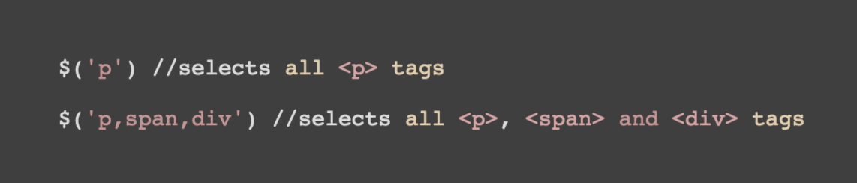
Using Selectors
Tag / Element Selectors
Selects all elements with the given tag name
Notes:
Selectors allow us to identify elements of an HTML page to interact with
A note about syntax: jQuery relies on the $ to identify code
If you are unfamiliar with JavaScript technologies, this might look a little weird but will become second-nature as you use it
The most basic selector is the Tag or Element selector
To select all <p> [Paragraph] elements, use the $(‘p’) selector
You can compound multiple selectors into the same call, like so: $(‘p, span, div’) but keep in mind jQuery will attempt to select or interact with every element that matches

Slide 8
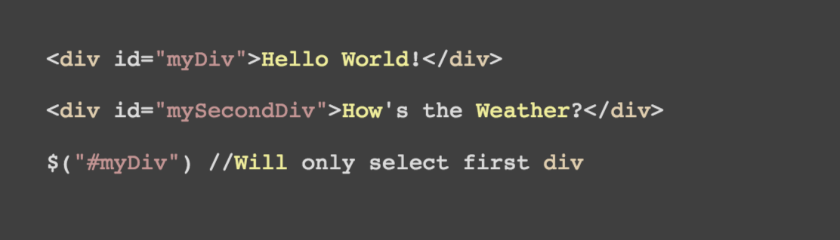
Using Selectors
ID Selectors
Selects single element with the given id attribute
Notes:
Another popular selector is the ID selector
HTML elements can be assigned a unique ID and jQuery can reference those IDs for interactions
The hash symbol before the text tells jQuery to look for a matching ID in the DOM
Keep in mind IDs should be unique and two elements with the same ID will cause problems beyond broken jQuery
In this example, my jQuery command will only select the first div element because it matches the ID of only that element

Slide 9
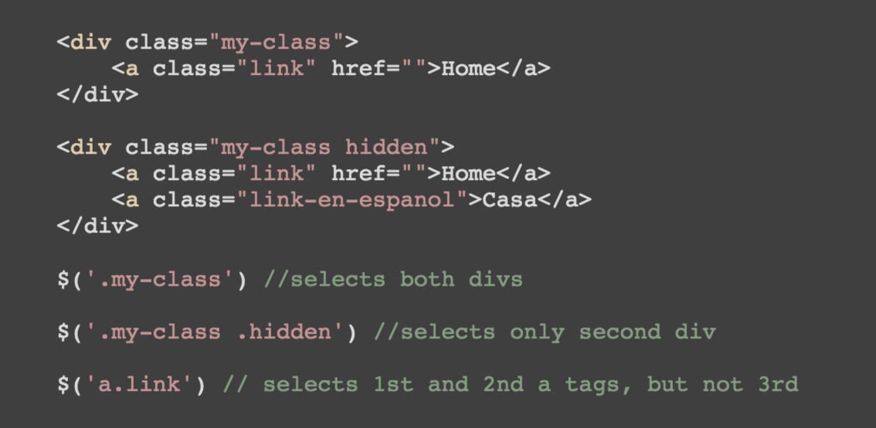
Using Selectors
Class Selectors
Selects all elements with the given class attribute
Notes:
Class selectors will select all elements that have been assigned a specified class attribute
Classes are commonly used to style types of elements with CSS rules, but jQuery can use them too.
The `.` before the text indicates to jQuery it should search for matching class attributes in the DOM
You can use the class selector to select one or many elements, depending on the specificity of your class attributes
You can also compound selectors where appropriate (3rd jQuery command in this example combines tag [a] selector and class [link] selector)
This is useful if you want to select all tags with a few exceptions

Slide 10
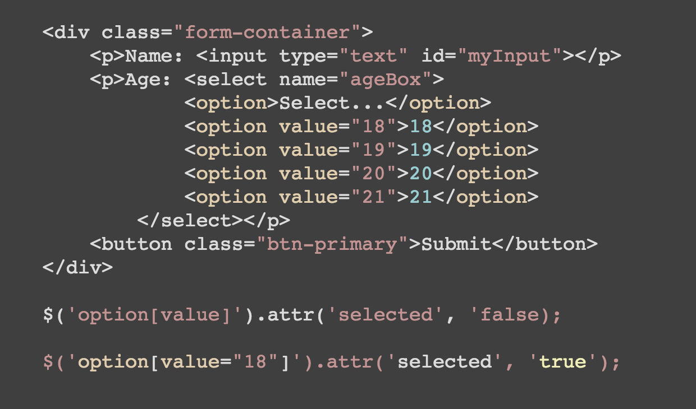
Using Selectors
Attribute Selectors
Selects all elements identified by a specified attribute
Notes:
As we get into DOM Manipulation and Event handling, there are more complex needs for selecting an element.
Attribute selectors are common ways to resolve these trickier situations.
An attribute selector uses a specified attribute like value, href in links, type on inputs, etc. to identify and select matching elements
Try not to get too caught up in what’s happening with the jQuery here.. We’ll discuss how we can use the selectors soon.

Slide 11
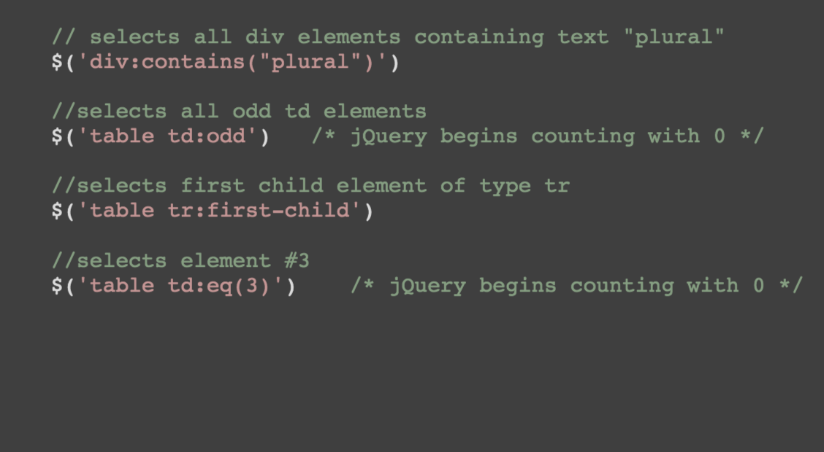
Using Selectors
Additional Selectors
Other examples that could be useful
Notes:
Filter selectors like these examples contain a basic selector like tag, a colon and then a filtering expression.
You can filter items on the text they contain, the odd or even order of their occurrence, their placement in the first or last position and by specific index numbers
These are more advanced examples and have very specific uses
You can see I’ve noted here that jQuery begins counting elements at 0
This is another little quirk of coding that may seem weird if you’ve never seen it before, but it will become more comfortable with practice.

Slide 12
Using Selectors
Reference
Use the jQuery API Docs for complete list of selectors and additional examples: https://api.jquery.com/category/selectors/
Notes:
jQuery provides an extensive online documentation and example repository. If you follow this link you can find more information on jQuery subjects with thorough examples
-- click link and show API --
Now, time for a demo!
[Example1.html]

Slide 13
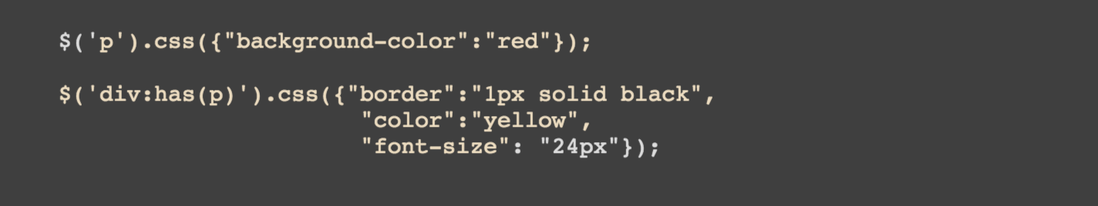
Dynamic Styling
.css()
How can we change the style of DOM objects dynamically?
We could use the .css() method
…but there is an easier way!
Notes:
Next we’re going to walk through using jQuery to dynamically update the style of our DOM elements.
So some of this might look familiar from the demo.. We could use the css method to style all of our elements...
-animation-
But there is an easier way!

Slide 14
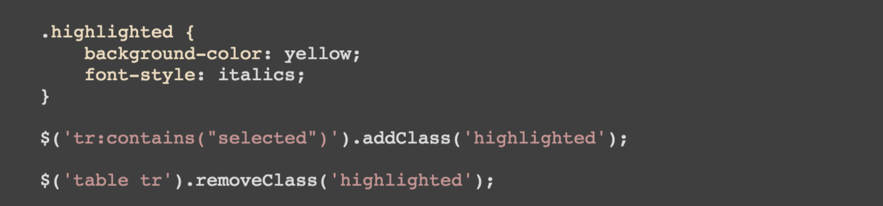
Dynamic Styling
Add / Remove Class
Methods to add or remove specific class from targeted element
Notes:
jQuery gives us method to add or remove a specific class from the targeted/selected element
We take our selector syntax and identify the element we want to target, in this case any tr [table row] containing the text selected
Then we chain our addClass method with the class we want to add, highlighted, in quotes
Note: this does not take into account the presence of the class already.. Could end up with duplicate classes if you’re not careful
The remove method works the same way.
We select all tr [table row] nested under a table [Table] element and chain our removeClass method
This will iterate through each matching element regardless of the presence of highlighted and remove it wherever it occurs
Can get a little messy if you selector isn’t focused tightly

Slide 15
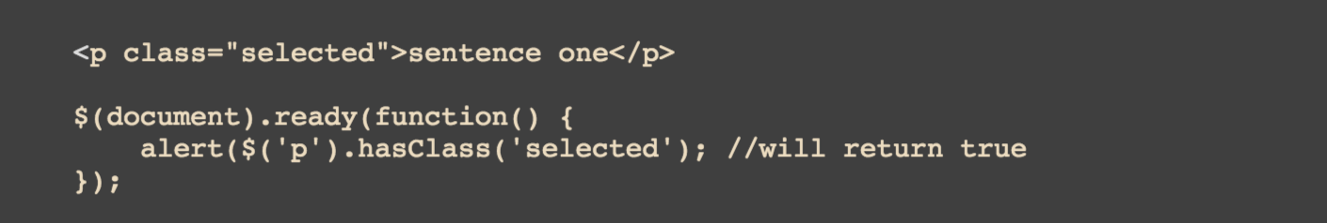
Dynamic Styling
Has Class
Methods to test for specific class on targeted element
Notes:
Luckily, jQuery has thought of this!
The has class method allows us to check for the presence of a class
We take our selector, p [Paragraph] tag, chain the hasClass function and pass in the class we’re looking for, highlighted
If the selected element has the provided class, we’ll get a true response – otherwise false
This isn’t particularly useful for us right now but can be helpful in some trickier situations.

Slide 16
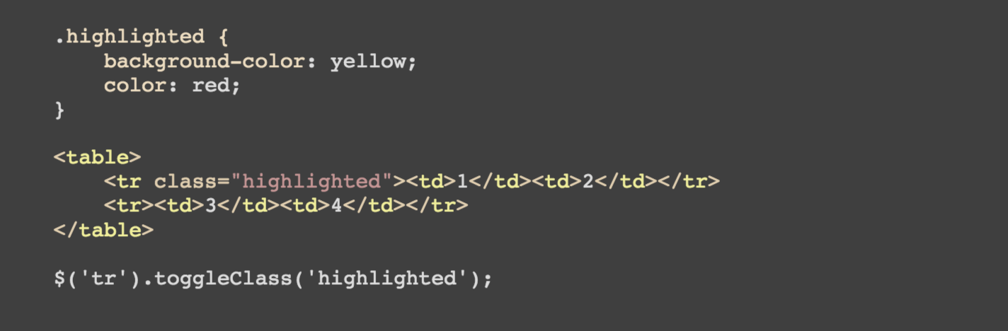
Dynamic Styling
Toggle Class
Methods to combine add/remove class methods on targeted element
Notes:
Finally, jQuery provides a toggleClass method to combine add and remove class methods on a targeted element
Think of toggle class like a light switch. There are two possible states: on or off. If the light is on and I flip the switch, the light will turn off.
Toggle class does the same thing..
I select my element, in this case all tr [table row], and chain the toggle class method with my selected class, highlighted
If a tr [table row] has the class highlighted already, it will be removed
If it does not, it will be added
This avoids the possibility of duplicate class entries that addClass can result in

Slide 17
Dynamic Styling
Reference
Use the jQuery API Docs for additional examples: https://api.jquery.com/category/manipulation/class-attribute/
Notes:
Here is the link to the jQuery API on the class attribute methods used for dynamic styling. Follow this link to find more information and examples
Now, time for a demo!
[Example2.html]

Slide 18
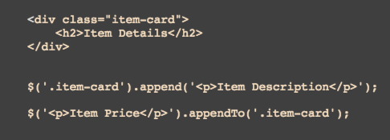
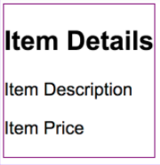
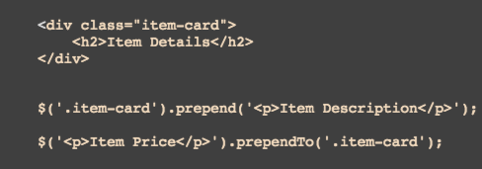
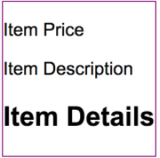
DOM Manipulation
Adding DOM Elements
.append() and .appendTo()
.prepend() and .prependTo()
Notes:
Now we get into the meat of building things with jQuery.
Document Object Model refers to the tree structure used to represent HTML documents. DOM manipulation simply means we are modifying this tree.
There are several options for adding an element to the DOM:
Append
Append to
Prepend
Prepend to
Now this can be confusing at first, but bear with me:
Append and AppendTo will add after the targeted element
With the append method, you identify the target element, chain the append method and supply the html to be appended
The appendTo method is the reverse, the identify the html to be appended, chain the appendTo method and supply the target element
It’s really up to you which one you use but I like append
Prepend and PrependTo will add before the targeted element and follows the same structure as append and appendTo
With prepend, you identify the target element, chain the prepend method and supply the html
With prependTo, you identify the html, chain the prependTo method and supply the target element
Again it’s your preference which you decide to use

Slide 19
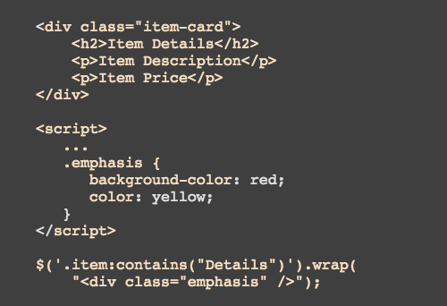
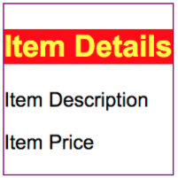
DOM Manipulation
Wrapping DOM Elements
.wrap()
<div class=“emphasis”></div>
Notes:
Next we will look at wrapping DOM elements
The wrap method provides a way to identify an element and wrap it in a containing element
You do this by specifying the selector of the target element, chaining the wrap method and providing a the html to wrap around the selected element
In this example, we are selecting the element containing the text Details and wrapping it with a div element with class emphasis.. This will wrap the class in a div tag and everything inside the div is given a red background with yellow font. That makes it pretty easy to see which item was affected
The html string I used to wrap the Item Details component may look a little strange. This is a modified format specifically for the wrap method that saves some typing for me by indicating I want to close the div without creating a closing tag. It is perfectly valid to use ”<div class=“emphasis”></div>” instead of the modified format I chose. -animation-

Slide 20
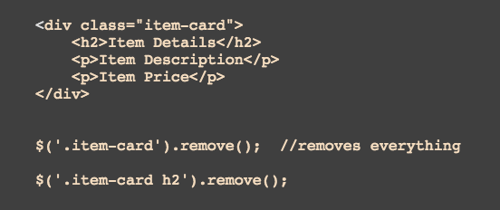
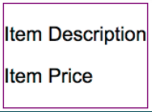
DOM Manipulation
Removing DOM Elements
.remove()
Notes:
Removing elements from the DOM is pretty straightforward with the remove method
If you select a parent element (like the div with class item-card), the remove method will remove everything
To remove only a piece of a component, you must target it specifically
The second example here will only remove the h2 [2nd header] element while the first removes the entire div

Slide 21
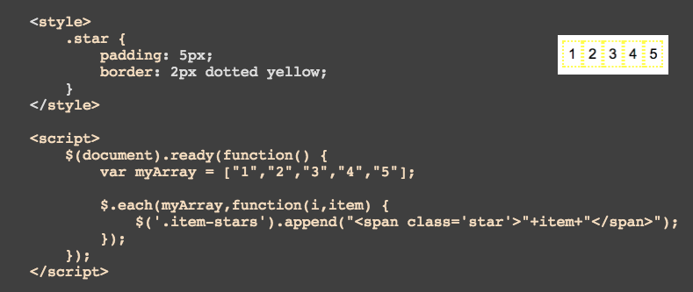
DOM Manipulation
Iterating Through DOM Elements
$.each()
Notes:
The last DOM manipulation we will cover is iteration with the $.each method
Iteration simply means we will go through a list of elements to perform other actions
If you are familiar with other coding methodologies, this is similar to a for each loop
In this example, I have created an array with the numbers 1-5
I take this array and pass it in as the first argument in my each method.
The second argument is a function with two parameters: 1) the variable I will use for counting and 2) the variable I will use to reference this item in the list
For each element in the list, I want to append this string of HTML
So I should end up with 5 styled elements when the iteration is complete

Slide 22
DOM Manipulation
Reference
Use the jQuery API Docs for a complete list of methods and additional examples: https://api.jquery.com/category/manipulation/
Notes:
These are just a few examples of the many, many DOM Manipulation options jQuery provides. Check out the manipulation category on the jQuery API for more examples and a complete list
Now time for another demo!

Slide 23
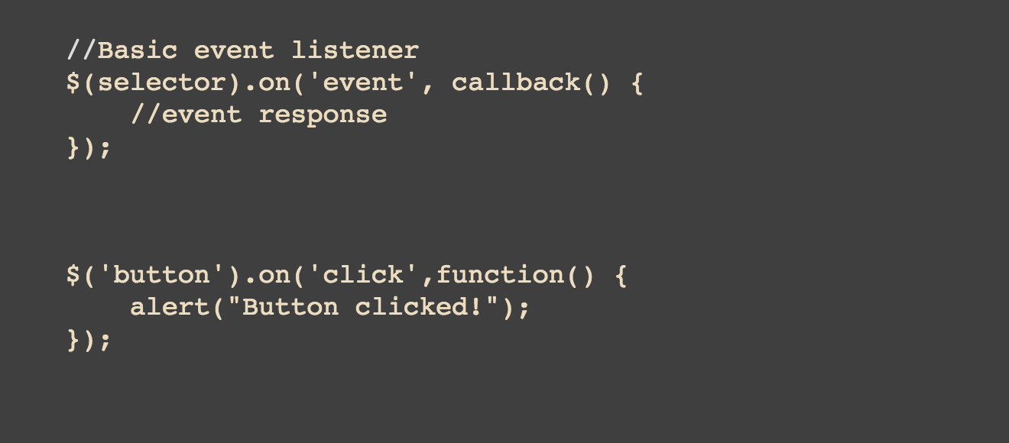
Event Handling
Event Basics
Event Listener syntax
Notes:
The last topic we are going to cover is event handling.
Events are what make our webapp reactive
The basic event listener syntax for jQuery is here
First we identify a selector and chain the `on` method
The first argument passed to the on method is the event we want jQuery to listen or wait for
The second argument is the callback or function that contains the event response
A basic event looks like this:
When any button is clicked (tag selector button, ‘click’ event name) we will trigger an alert saying the button was clicked (callback function)
There are a lot of event types available for interaction with jQuery but we will cover just a few

Slide 24
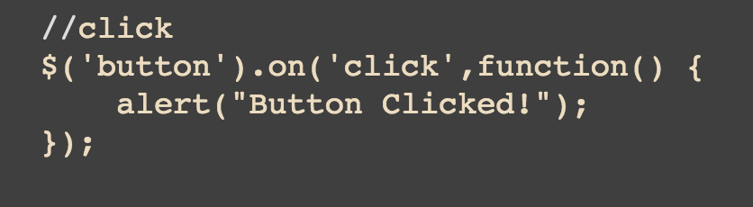
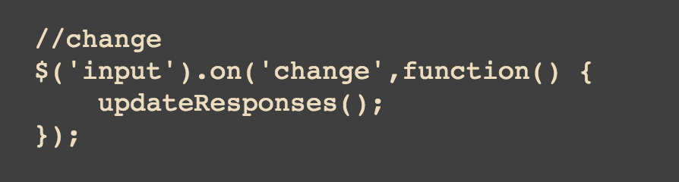
Event Handling
Types of Events
Click event
Change event
Notes:
The previous example is your basic click event
It can be applied to any clickable elements (divs, spans, p tags, images, basically anything) but primarily reserved for buttons and links
The change event is usually applied to input elements like text or selects. The syntax is the same:
Provide a selector, pass the change event name, pass the callback function and trigger the updateResponses method
If the event response is something that can be triggered in other ways, it’s common to include a named method containing that code instead of rewriting it in the callback method

Slide 25
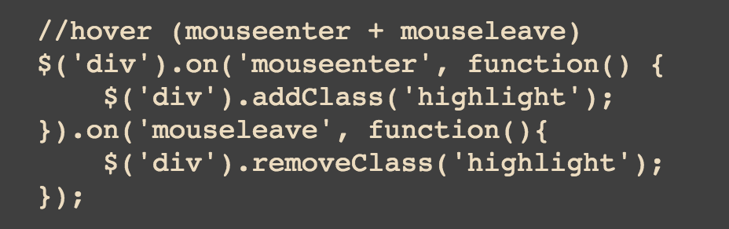
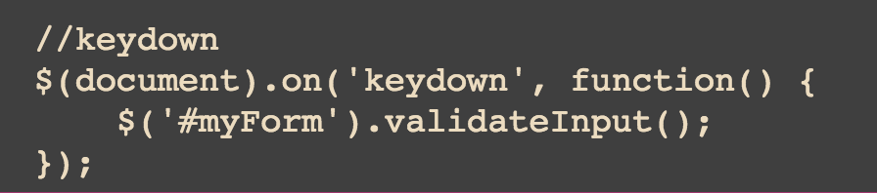
Event Handling
Types of Events
“Hover” event
Keydown event
Notes:
Hover is a little bit of an edge case in jQuery because there really isn’t a “hover” event, rather there is the start hovering [mouseenter] and stop hovering [mouseleave] events.
This syntax is the standard form but there is a shorthand in the jQuery API
So I select a div, chain the on method and set the mouseenter response. Instead of reselecting the div to chain the on mouseleave response
I can chain the second on method directly after the first and provide the mouseleave behavior too
Finally the keydown event will be triggered any time a key is pressed. In this example, I selected the entire document because I want the callback response to run no matter what element receives the keystrokes..
You can bind this event to a specific element as well though

Slide 26
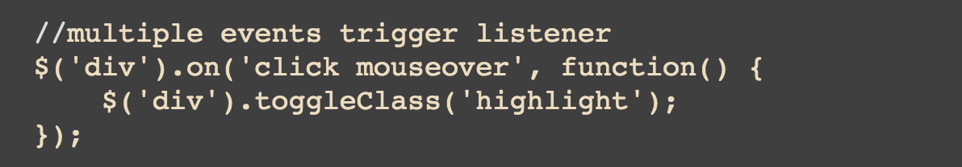
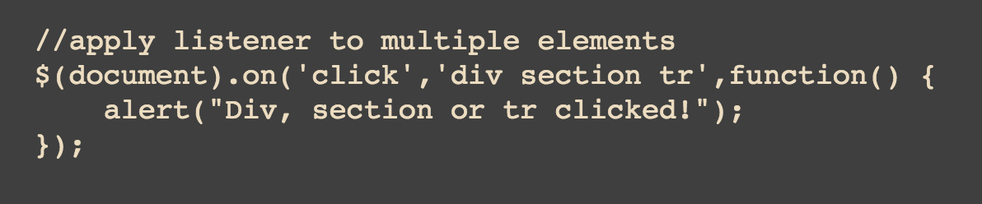
Event Handling
Multiple Item Events
Multiple events trigger same response
Apply listener to multiple elements
Notes:
One more note for jQuery event handling..
You can set multiple events on a single selector
Here I have set a div to trigger the toggleClass method if I mouseover or click the element
Likewise, I can apply an event listener to multiple elements
In this case, I will select the document and provide an additional argument in the on method
Argument 1 is still the event name
Argument 2 is the list of elements to apply the listener to
And Arugment 3 is the callback function

Slide 27
Event Handling
Reference
Use the jQuery API Docs for a complete list of methods and additional examples: https://api.jquery.com/on/
The API includes event methods in addition to on but on is the preferred handler
Notes:
As always, the API provides an exhaustive list of event handling methods and examples
There are methods that can be used for event handling other than on, but on is generally the preferred standard in the latest version of jQuery

Slide 28
Any Questions?
Bsullivan@captechconsulting.com
Slides available for download at github.com/brsullivan
Notes:
And that’s it! You are introduced to jQuery.
As a reminder, you can find the slides at github.com/brsullivan
If you have questions or comments, you can reach me at Bsullivan at captechconsulting dot com

Slide 29
Thank You

